Slide 1
Growth of Functions

Slide 2
How to analyze algorithms?
Compare execution times?
- times are specific to a particular computer !!
- A computer could be multi tasking
    - A 3 Ghz Windows machine chip will run an algorithm at a different speed than a 3 Ghz Macintosh
Count the number of statements executed?
- number of statements vary with the programming language and individual programmer.
  - different CPU’s have different machine instructions
  Need: An analysis independent of machine time, programming style, etc.
Notes:
Discrete Mathematics and its Applications
26年 11月 8日
(c)2001-2002, Michael P. Frank

Slide 3
How does one measure algorithms
We can loosely define a “step” as a single computer operation
  A comparison, an assignment, etc.
- Express running time as a function of the input size n (i.e., f(n)).
  To compare two algorithms with running times f(n) and g(n), we need a rough measure of how fast a function grows.

Slide 4
Growth of Functions
Although we can sometimes determine the exact running time of an algorithm, the extra precision is not usually worth the effort of computing it.
For large inputs, the multiplicative constants and lower order terms of an exact running time are dominated by the effects of the input size itself.

Slide 5
Function growth rates
For input size n = 1000
O(1) 1
O(log n) ≈10
O(n) 10³
O(n log n) ≈10⁴
O(n²) 10⁶
O(n³) 10⁹
O(n⁴) 10¹²
O(n^{c}) 10^{3*c} c is a consant
2^{n} ≈10³⁰¹
n! ≈10²⁵⁶⁸
n^{n} 10³⁰⁰⁰
Many interesting problems fall into these categories

Slide 6
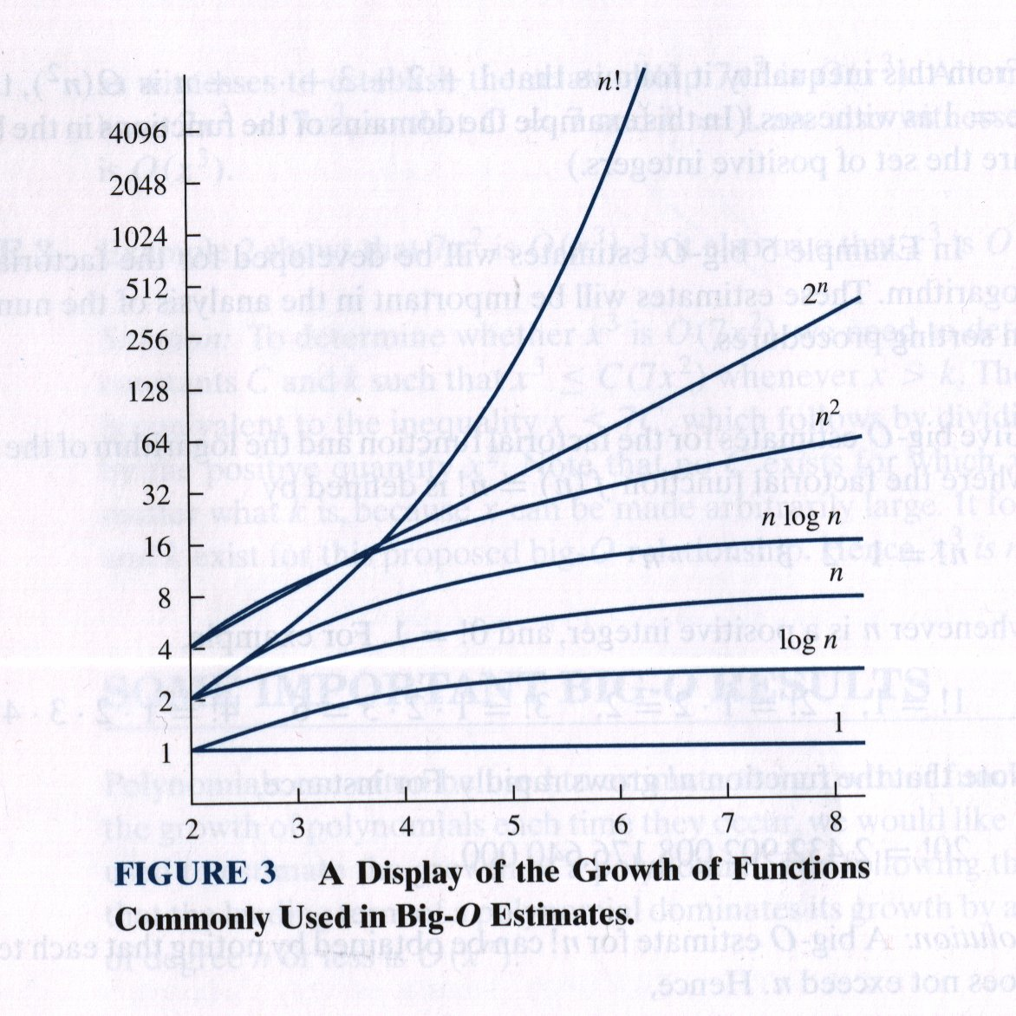
Function growth rates
Logarithmic scale!

Slide 7
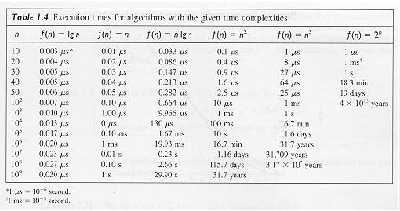

Slide 8

Asymptotic Analysis
• Ignore machine-dependent constants.
• Look at growth of

Slide 9
Example
Algorithm Cost
sum = 0; c₁
for(i=0; i<N; i++) c₂
for(j=0; j<N; j++) c₂
sum += arr[i][j]; c₃
------------
c₁ + c₂ x (N+1) + c₂ x N x (N+1) + c₃ x N²
<= c₃ + c₃ x (N+1) + c₃ x N x (N+1) + c₃ x N²
<= c_{3 .}K.N² = O(N²)
if max(c_{1,} c_{2 ,}c₃ ) = c₃

Slide 10


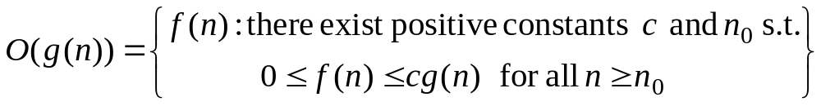



O-notation
For a given function , we denote by the set of functions
We use O-notation to give an asymptotic upper bound of a function, to within a constant factor.
means that there exists some constant c s.t. is always for large enough n.

Slide 11
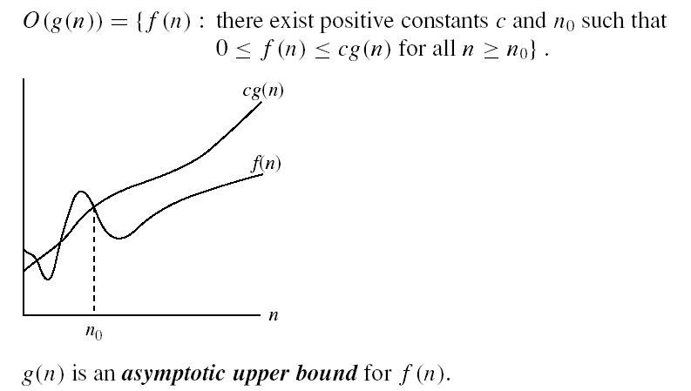
Asymptotic notations
O-notation

Slide 12
O-notation Example
For a given function , we denote by the set of functions
5 n² +7n +8
4 n² + 5n²

Slide 13
Questions
  Is 2n² = O(n³) ?
  Is n² = O(n²):
  1000n²+1000n = O( ?)
  n = O(n²) ?

Slide 14
  2n² = O(n³):
  n² = O(n²):
  1000n²+1000n = O(n²):
  n = O(n²):
2n² ≤ cn³ ⇒ 2 ≤ cn ⇒ c = 1 and n₀= 2
n² ≤ cn² ⇒ c ≥ 1 ⇒ c = 1 and n₀= 1
If 1000n²+1000n ≤ 1000n²+ n² =1001n²
^{Then} c=1001 and n₀ = 1000
n ≤ cn² ⇒ cn ≥ 1 ⇒ c = 1 and n₀= 1

Slide 15
No Uniqueness
There is no unique set of values for n₀ and c in proving the asymptotic bounds
Prove that 100n + 5 = O(n²)
  100n + 5 ≤ 100n + n = 101n ≤ 101n²
  for all n ≥ 5
  n₀ = 5 and c = 101 is a solution
  100n + 5 ≤ 100n + 5n = 105n ≤ 105n²
  for all n ≥ 1
  n₀ = 1 and c = 105 is also a solution
  Must find SOME constants c and n₀ that satisfy the asymptotic notation relation

Slide 16
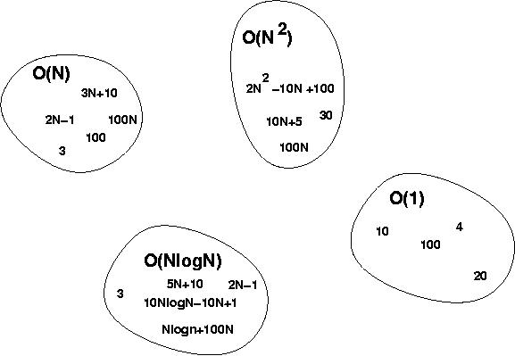
Big-O Visualization
O(g(n)) is the set of functions with smaller or same order of growth as g(n)

Slide 17

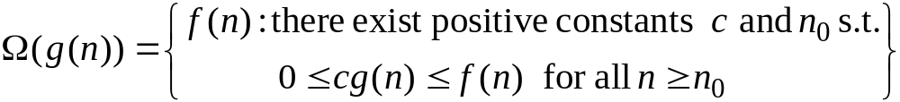


Ω-Omega notation
For a given function , we denote by the set of functions
We use Ω-notation to give an asymptotic lower bound on a function, to within a constant factor.
means that there exists some constant c s.t.
is always for large enough n.

Slide 18
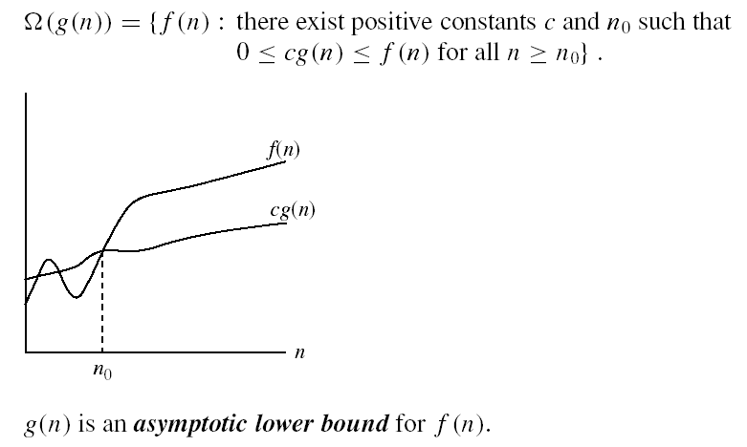
Asymptotic notations (cont.)
Ω - notation
Ω(g(n)) is the set of functions with larger or same order of growth as g(n)

Slide 19


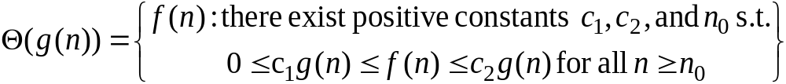







-Theta notation
For a given function , we denote by the set of functions
A function belongs to the set if there exist positive constants and such that it can be “sand- wiched” between and for sufficienly large n.
means that there exists some constant c₁ and c₂ s.t. for large enough n.

Slide 20


Asymptotic notations (cont.)
Θ-notation
Θ(g(n)) is the set of functions with the same order of growth as g(n)

Slide 21
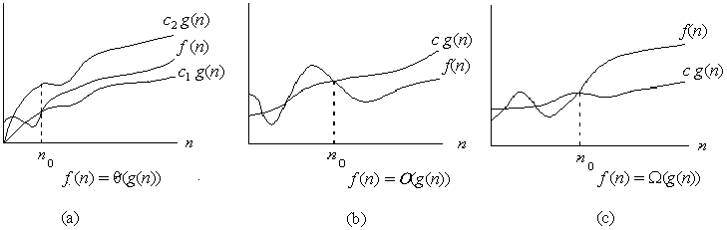

Asymptotic notation
Graphic examples of and .

Slide 22

In Class Problems
½ n² -3n = ( ? )
2+1/n = (?)
Is 2^{n+1} = O(2^{n}) ?
Is 2^{2n} = O(2^{n}) ?
Prove max(f,g) = (f + g)
Prove log(n!)= (n log n)
Prove S= ∑^{n}_{i=1} i = (n²)

Slide 23
½ n² -3n
n^{2 .}c₁<=½ n² -3n <= c₂. n²
c₁<=½ - 3/n <= c₂
For n₀=7, we can pick c₁=1/14
and c₂=1/2
2<= 2 + 1/n <=3
Hence 2+1/n = (1)
2^{n+1} <=2.2^{n} for c=2 and n₀=1
Is 2^{2n} = O(2^{n}) ?
To show that there exists a c
such that 2^{2n} <= c. 2^{n}
➔ 2^{2n} / 2^{n}<= c as n-> infinity
➔ 2^{n} <= c as n-> infinity . Contradiction!!
Prove max(f,g) = (f + g)
Let max(f,g)=f. Find c1, c2 such that
c1. (f+g) <= f <= c2. (f+g)
c1=1/2 since even at f=g, ½(f+g) <= f .
Similarly c2=1 since even at g=0 , f<=1(f)
Prove S= ∑^{n}_{i=1} i = (n²)
Prove log (n!) = (n log n)

Slide 24
Log(n!)= log(n*n-1*n-2*....1)
<= log(n*n*n*...n)
=log(n^{n})= n log n
Thus log(n!)<=n logn
Log(n!)= log(n*n-1*n-2*....1)
>= log((n/2+1)*(n/2+2)*....*n)>=log(n/2*n/2*..*n/2) //n/2 times
= log n/2 ^{n/2}
=n/2 log(n/2)= n /2 * log n – n/2
Prove n /2 * log n – n/2 = omega(n logn)
To show log(n!)>= n /2 * log n – n/2 >=c nlog n

Slide 25
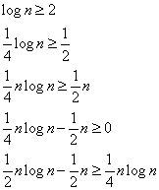
For n ≥ 4,
Hence c₂=1/4 and n0=4
So, log n! = Ω(n log n)

Slide 26
Prove
  5n² = Ω(n)
  100n + 5 ≠ Ω(n²)
  n = Ω(2n),
  n³ = Ω(n²),
  n = Ω(logn)

Slide 27
Examples
  5n² = Ω(n)
  100n + 5 ≠ Ω(n²)
  ∃ c, n₀ such that: 0 ≤ cn ≤ 5n²
⇒ cn ≤ 5n²
⇒ c = 1 and n₀ = 1
∃ c, n₀ such that: 0 ≤ cn² ≤ 100n + 5
100n + 5 ≤ 100n + 5n (∀ n ≥ 1) = 105n
cn² ≤ 105n
⇒ n(cn – 105) ≤ 0
Since n is positive ⇒ cn – 105 ≤ 0
⇒ n ≤ 105/c
⇒ contradiction: n cannot be smaller than a constant

Slide 28

Theorem
For any two functions and , we have
if and only if

Slide 29
L2.<number>

Slide 31
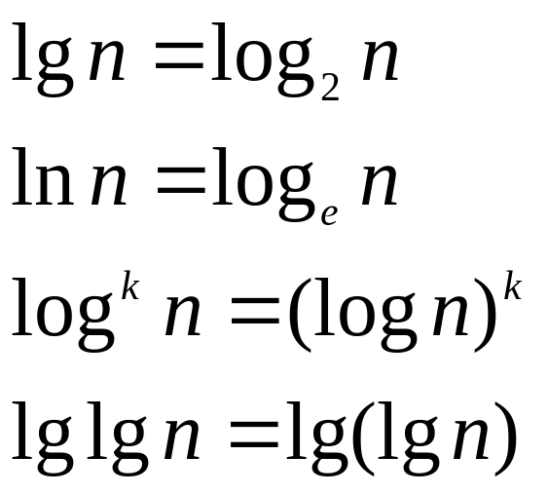
Standard notations and common functions
Logarithms:

Slide 32
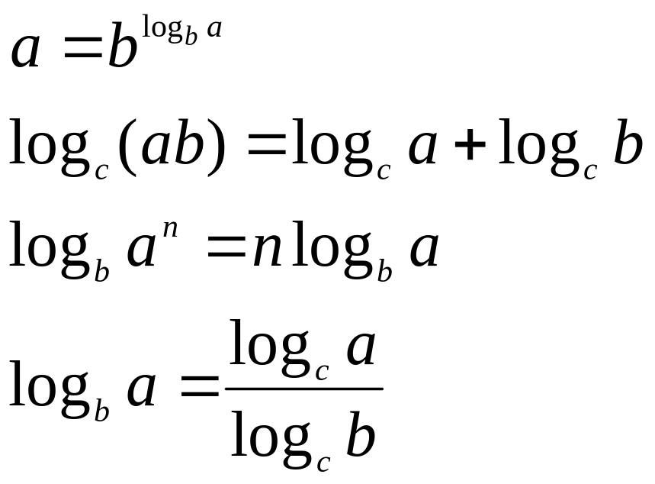
Standard notations and common functions
Logarithms:
For all real a>0, b>0, c>0, and n

Slide 33
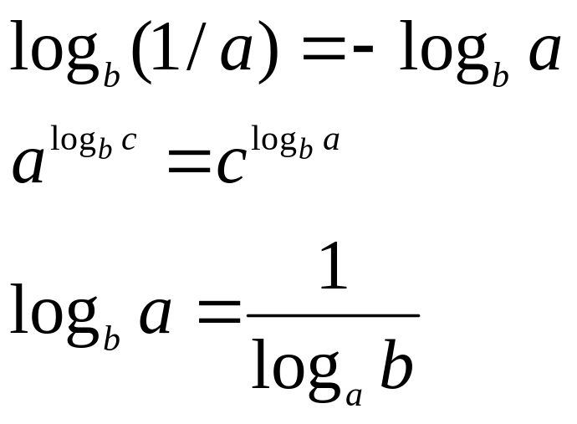
Standard notations and common functions
Logarithms:

Slide 34
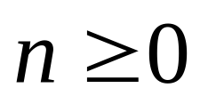
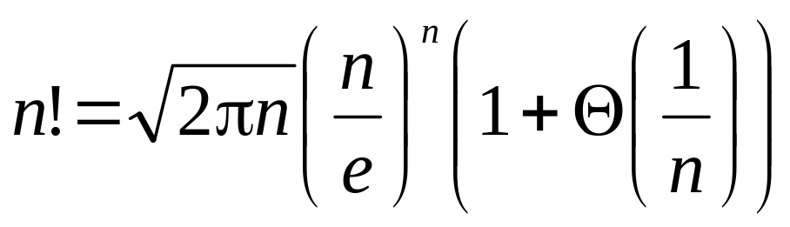
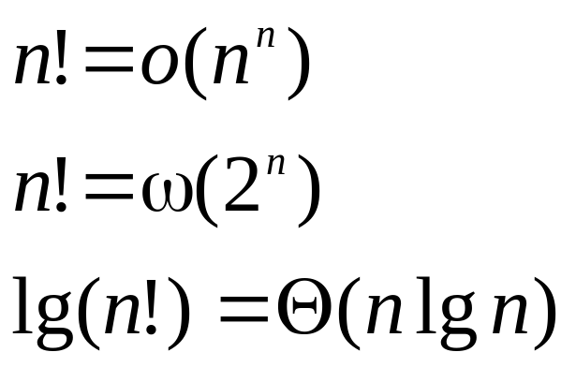
Standard notations and common functions
Factorials
For the Stirling approximation:

